Slide 1
NLP Analysis of Robert Greene's Works
Comparing The 48 Laws of Power and The Laws of Human Nature
Yousef Askar : 100001697
Abdelmalek abdou :100003159

Slide 2

Robert Greene (born May 14, 1959) is an American author best known for writing about power dynamics, strategy, seduction, mastery, and human behavior.

Slide 3
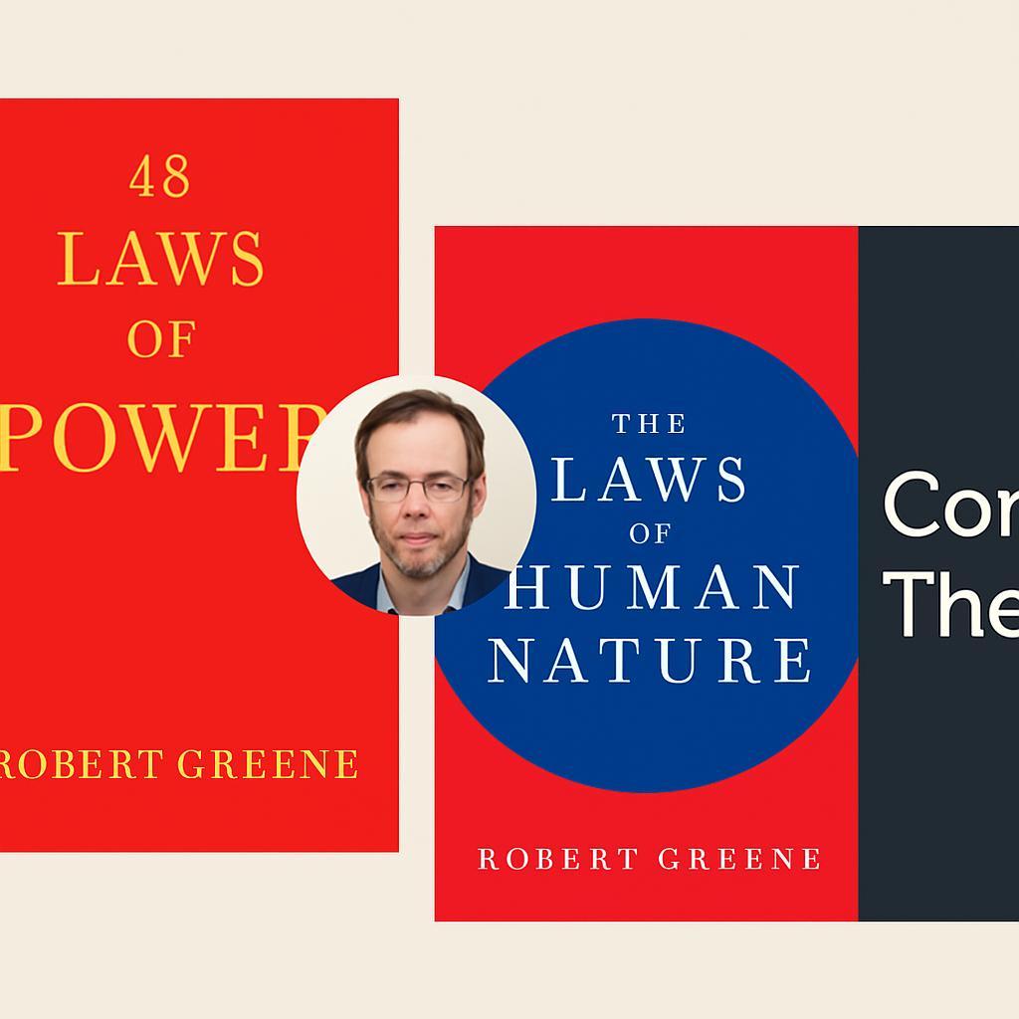
Readers assume both books follow the same strategic mindset and rhetorical style because they are written by the same author.
• The Reality:
Our data shows the books differ significantly:
The 48 Laws of Power uses short, punchy, tactical sentences,
while The Laws of Human Nature uses longer, reflective, psychology-driven paragraphs.
• The Twist:
These stylistic differences reveal Greene’s shift in purpose:
Power teaches external strategy and manipulation,
while Human Nature explores internal emotions, motives, and self-awareness.

Slide 4
Research Question
Does Robert Greene’s writing style change when he shifts from strategy to psychology—and what does the data reveal about his evolution as an author?

Slide 5
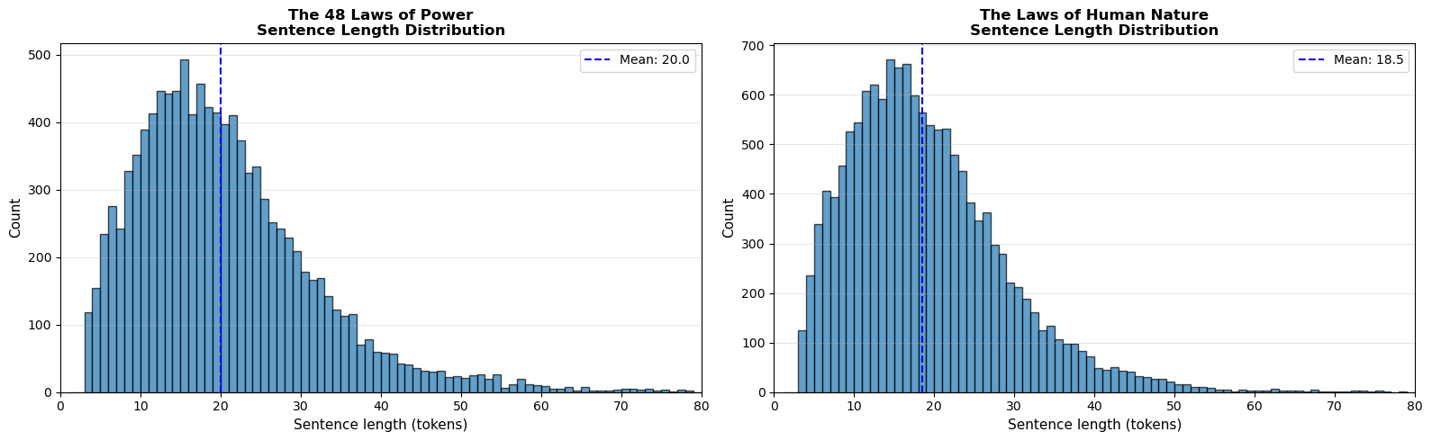
Sentence Length Analysis: Power vs Human Nature
Robert Greene uses noticeably different writing rhythms in each book.
  The 48 Laws of Power uses shorter, sharper sentences → creates a tactical, punchy tone.
  The Laws of Human Nature uses slightly longer and smoother sentences → creates a reflective and explanatory tone.
  The difference shows how Greene shifts from strategy to psychology.

Slide 6
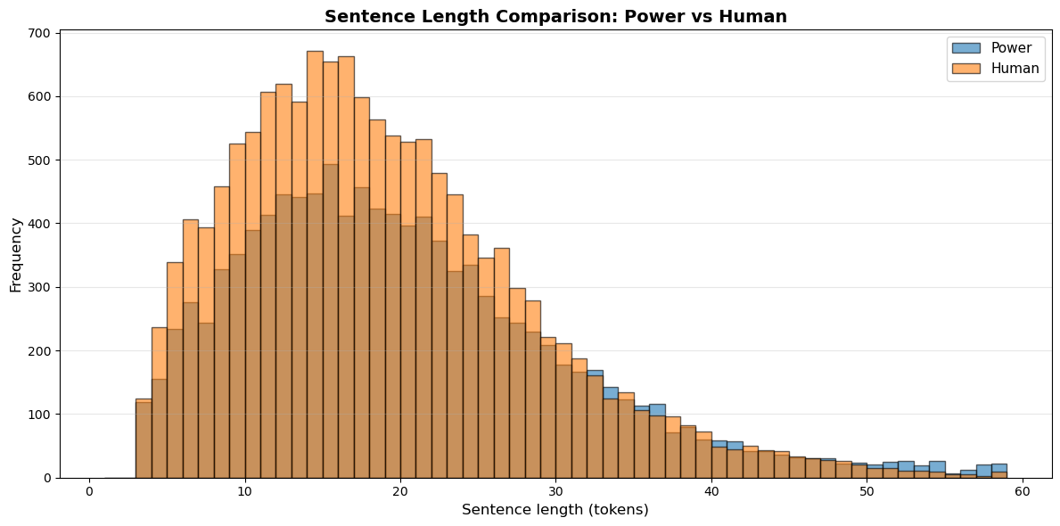
sentence Length Comparison: Power vs Human Nature
  Both books peak between 10–20 tokens, but they peak at different intensities.
  Human Nature has a smoother and more consistent curve, meaning the writing flows more evenly.
  Power has more variation and more very short sentences, matching its direct, tactical tone.
  The overlap shows they share Greene’s voice, but the shape of the distributions reveals different rhetorical intentions.

Slide 7
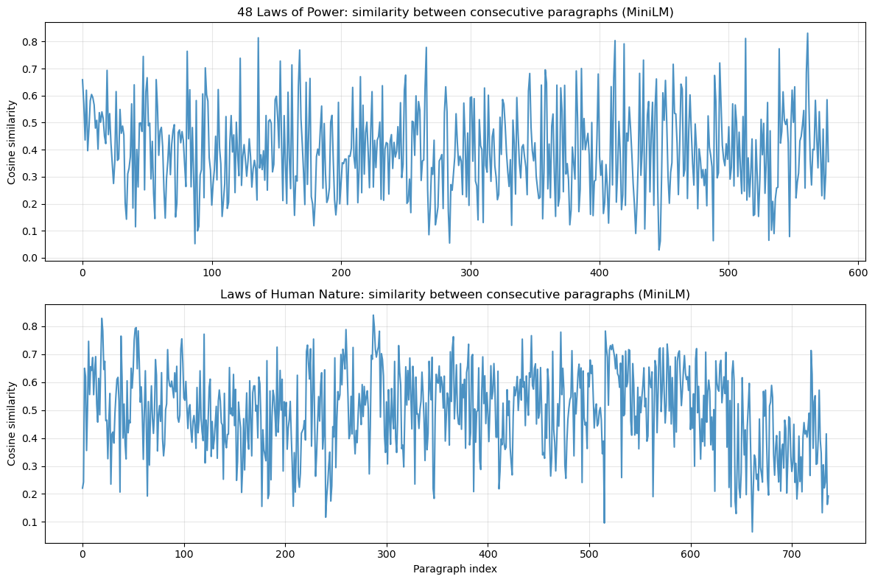
Topic Drift Across Paragraphs (MiniLM Embeddings)
48 Laws of Power (Top Graph):
  The cosine similarity jumps up and down aggressively.
  Indicates Greene shifts topics frequently → sharp transitions.
  Matches the book’s purpose: fast, tactical, punchy lessons.
Laws of Human Nature (Bottom Graph):
  Similarity is more stable and less chaotic.
  Shows smoother transitions between ideas.
  Matches the psychological, explanatory style of the book.

Slide 8
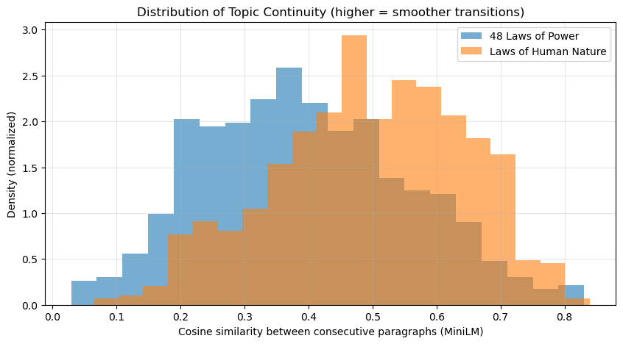
Distribution of Topic Continuity (Higher = Smoother Transitions)
48 Laws of Power (blue):
  Peaks around 0.3–0.4 cosine similarity.
  Indicates frequent shifts and less continuity.
  Matches its tactical, fast-paced structure.
Laws of Human Nature (orange):
  Peaks around 0.5–0.6 similarity.
  Shows higher coherence and smoother transitions.
  Reflects its purpose: deep psychological explanation.

Slide 9
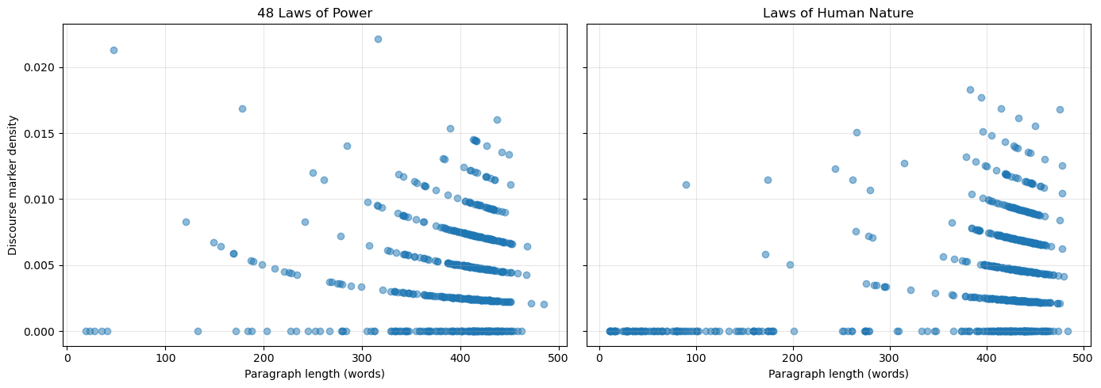
Discourse Marker Density: Power vs Human Nature
48 Laws of Power (left plot):
  Most paragraphs have very low discourse marker density.
  Greene uses fewer connectors → writing feels direct, commanding, and abrupt.
  Matches the book’s strategic, instructional style.
Laws of Human Nature (right plot):
  Higher density of markers such as because, however, therefore.
  Indicates a more explanatory and analytical writing style.
  Greene uses reasoning to build psychological arguments.

Slide 10
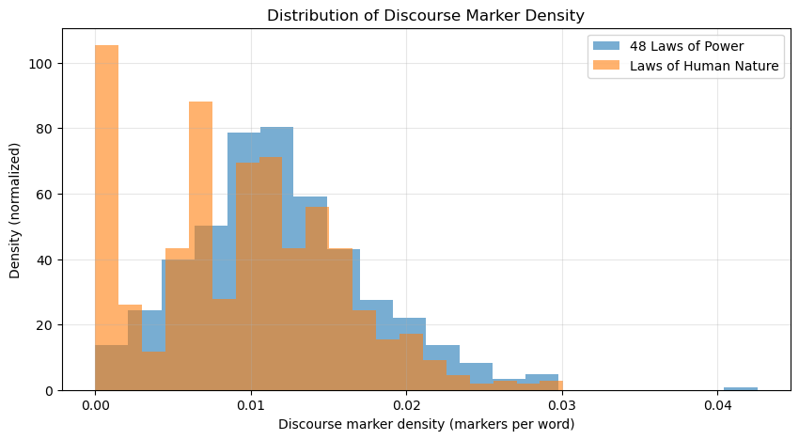
Distribution of Discourse Marker Density: Power vs Human Nature
48 Laws of Power (blue):
  Density peaks around 0.01–0.015 markers per word.
  The distribution is wider, meaning some paragraphs are extremely direct with zero markers, while others use more.
  Reflects the book’s command-like, abrupt, rule-based style.
Laws of Human Nature (orange):
  Peaks lower (closer to 0.005–0.01), but stays more consistent.
  Suggests a steady use of explanation markers.
  Reinforces the book’s analytical and reflective tone.

Slide 11

Why We Used These Codes
Analyzing tone and complexity in Greene's works
To Measure Writing Style Objectively
To Compare the Two Books Fairly
We used Python and NLP tools because style is difficult to judge by intuition alone.
The code allowed us to quantify Greene’s writing:
  Sentence length
  Paragraph structure
  Topic continuity
  Logical connector (discourse marker) density
The goal was to see whether Robert Greene changes his style between
The 48 Laws of Power and The Laws of Human Nature.
Using code ensured:
  No bias
  Same method for both books
  Clean, accurate comparison

Slide 12
In Conclusion
Analyzing key term frequencies and distributions
The 48 Laws of Power uses a fast, tactical writing style.
The Laws of Human Nature has a smoother, more reflective style.
Shorter and more variable sentences → sharper, more direct communication.
Longer, more consistent sentences → deeper explanations and analysis.
Discourse markers reveal contrasting rhetorical strategies.
Power uses fewer logical connectors (e.g., “however”, “because”) → creates an authoritative tone
.
Human Nature uses more reasoning markers → supports psychological arguments.

Slide 13

Thank You!
Yousef Askar
xcca12@gmail.com
+4917684656742
abdelmalek abdou
abdelmalekaabdosaleh”gmail.com
+4917659882132

